Slide 2
Agenda
Activity Presenter
Welcome PEA/City
Project Purpose, Benefits, Timeline PEA/City
Technical Overview Ameresco
Engagement Opportunities Ameresco/CMC
Questions and Answers All

Slide 3
City of Philadelphia and Philadelphia Energy Authority Project Overview
Purpose
Benefits
Timeline

Slide 4
City Project Team

Slide 5
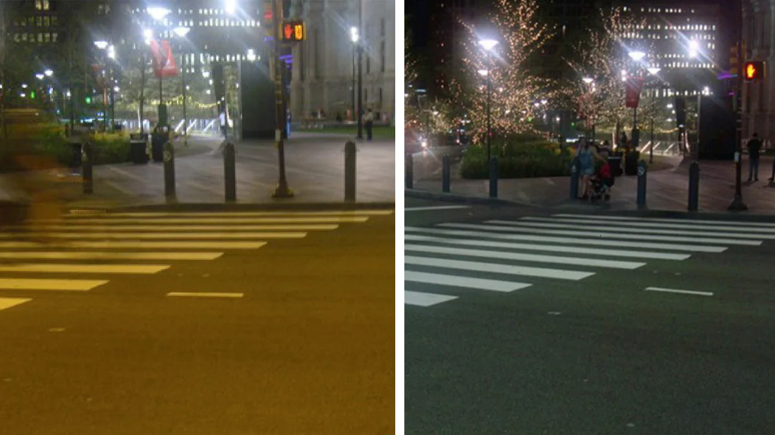
Philly Streetlight Improvement Project
Scope of Work:
Replace 120,000+ high pressure sodium fixtures with LEDs
Link all newly- and already-converted (10,000+) LEDs to a lighting management system
Audit to include cobraheads (roadway), alleyway, and decorative (residential and commercial corridor) lighting
Left: High Pressure Sodium lighting Right: Light Emitting Diode (LED) Lightning | Source: Office of Sustainability

Slide 6
Benefits
Supports public safety
Enhances visibility to improve safety for pedestrians, bicyclists, and motorists (Vision Zero Alignment)
Advances the City’s goals for carbon and electricity use reduction as the largest municipal energy conservation project to date
Adds remotely controlled lighting and outage monitoring that will create operational efficiencies for the Streets Department Provides a communications network for future Smart City applications
Supports local, diverse businesses and individuals through an Economic Opportunity Plan and a workforce development agreement
Pays for itself through energy savings

Slide 7
Progress to Date
RFQ for LED Streetlighting Project released
January 2020
Four contractors qualified to participate in RFP
RFP for LED Streetlighting Project released
March 2021
Ameresco selected
October 2021
Ordinances passed by PHL City Council
May-June 2022
Project kickoff including citywide field audit
July 2022
Project naming and website launch
September 2022
Trial installations and stakeholder engagement kickoff
October 2022

Slide 8
Project Timeline
Complete field audit
November 2022
(Q2 FY 2023)
Lighting management system and fixture selection and design
Q2 - Q3 FY 2023
Final Project Approval
Q3 FY 2023
Installation
Q4 FY 2023 - Q4 FY 2025
Q1 = Jul - Sep | Q2 = Oct - Dec | Q3 = Jan - Mar | Q4 = Apr - Jun

Slide 9
Ameresco Technical Overview
Peer Cities
Project Development Process
Streetlight Color Temperature

Slide 10
LED Street Lighting Evolution
Many of the largest cities in North America have converted their street lights to LED, including Chicago, New York, Los Angeles, Phoenix, Boston
According to the Department of Energy, LED street light penetration grew from 28% to 49% between between 2016 and 2018, and current estimates exceed 65%
Most streetlights are owned by utilities and they have been slower to convert than cities that own their own streetlights
Ameresco has completed 62 projects encompassing nearly 900,000 street lights
Cities are increasingly including networked controls in these projects

Slide 11
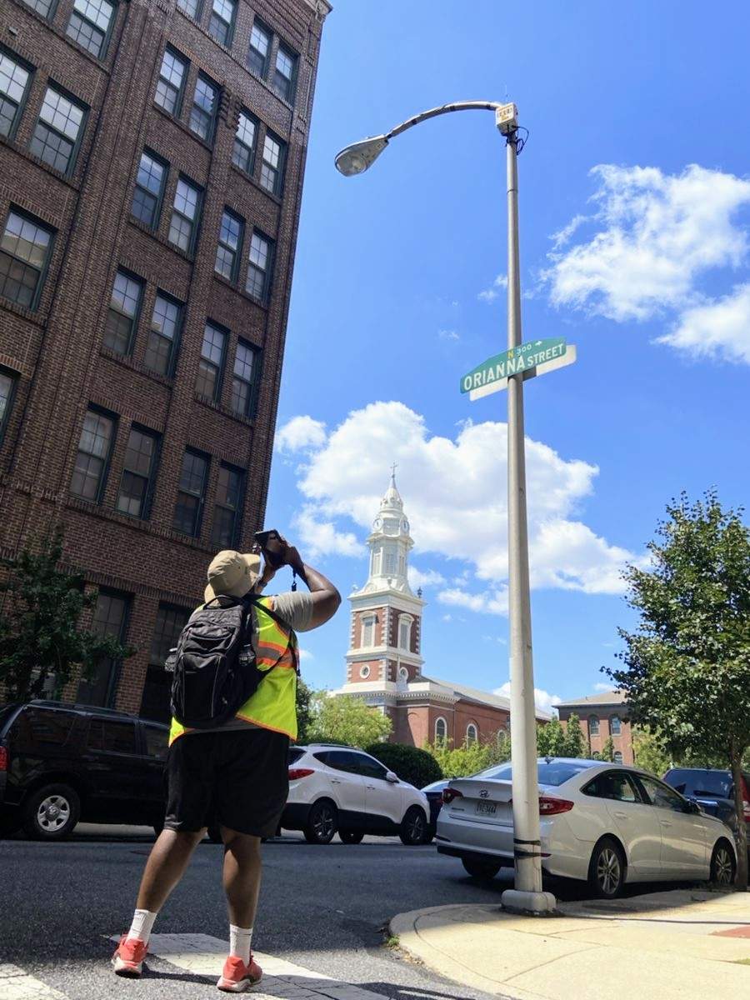
Comprehensive Project Development Process
Citywide GIS-based audit of existing streetlight system
Community outreach, soliciting streetlight preferences as input to design process
Program website and community outreach events
Trial installations and community surveys
Streetlight and control system evaluation and selection
Includes assessment of future Smart City opportunities
Standardized Lighting Design ensuring the “right” light source is installed for all City typical roadway applications and special needs
Investment Grade Audit Report with project costs, annual savings and cash flows

Slide 12
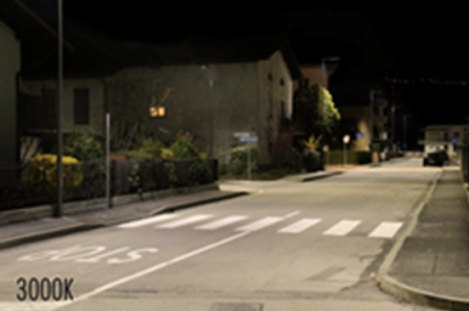
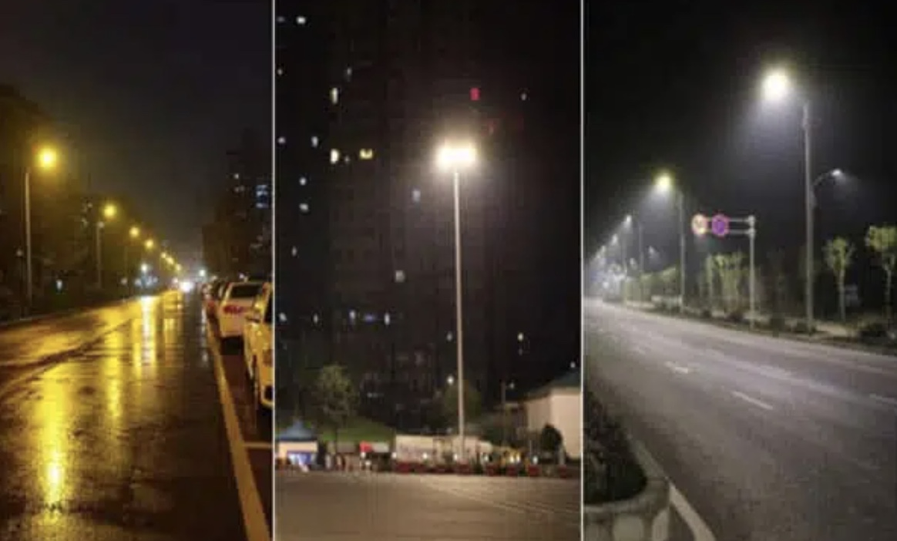
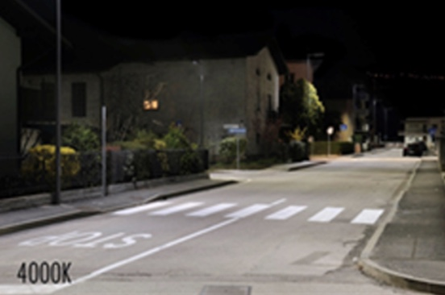
Streetlight Color Temperature
=<3000K CCT recommended by AMA, IDA & others
~4000K offers improved object detection >35 MPH
.
“Warmer” color
Same lumen output
HPS 2100K
LED 3000K
LED 4000K
Note that higher color temperature does not mean more light.
“Cooler” color

Slide 13
Ameresco/CMC Engagement Opportunities
Trial Installations
Engagement Events

Slide 14
Trial Installations – Why
Primary goal of trial installations is to solicit community feedback on your preferences on streetlight color temperature.
Placard sign will be placed on each trial streetlight pole for accessing the survey and providing feedback.
Community outreach events will be held at the trial locations in the coming weeks to collect survey feedback on the installations.
Individuals can visit trials on their own and take self-guided surveys too.

Slide 15
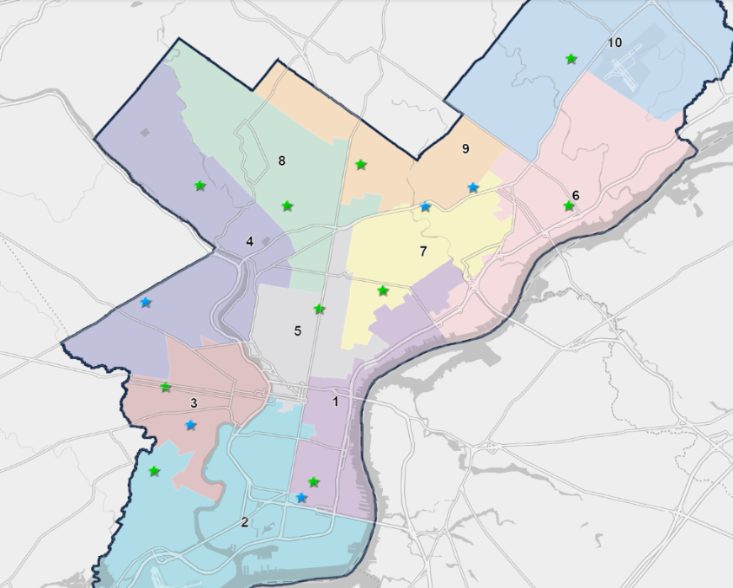
Trial Installations - Where
10 Residential Locations
Council District | Address
District 1 | 700 Block of Tree Street
District 2 | 2100 Block of Gould Street
District 3 | 5400 Block of Sansom Street
District 4 | 6100 Block of Lawnton Street
District 5 | 2300 Block of N. Carlisle Street
District 6 | 7100 Block of Vandike Street
District 7 | 3000 Block of B Street
District 8 | 160 Block of W. Queen Street
District 9 | 6000 Block of N. 10th Street
District 10 | 9500 Block of Wistaria Street

Slide 16
Trial Installations - Where
5 Driveway Locations
Council District | Driveway End | Driveway End2 | Description
District 2 | 1008 Johnston | 970 West Oregon | Middle of the Driveway
District 3 | 4981 Chester Ave | 5007 Springfield Ave | Closest to Chester
District 4 | 2331 N 58th | 2350 North 57th St. | Closest to 58th
District 7 | 5201 Garland | 4218 Roosevelt Blvd | Closest to Garland
District 9 | 1315 Comly | 1315 Benner St | Closest to E. Comly

Slide 17
Survey Instructions to Residents
Welcome to the PSIP Trial Installation at ___ Block of ___ Street
Please go to ____ Street for the best view of the trial installations.
Across the road to your left in front of ____ Street is Trial Streetlight A, which is using a High Visibility Pure White LED source.
Across the road to your right in front of ____ Street is Trial Streetlight B, which is using a High Comfort Warm White LED source.
For reference, Trial Streetlight A and B deliver the same amount of light and really only differ in the color of light.
For reference, the current older technology less efficient high pressure sodium streetlights are further to the left of Trial Streetlight A and further to the right of Trial Streetlight B.
When answering the following survey questions, please do not look directly at the light source BUT rather look at the general street area around the base of the pole including the road, sidewalks and homes.

Slide 18
Community Survey

Slide 19
Trial Posters on Poles

Slide 20
Community Outreach Opportunities
Our team will visit each of the trial areas with three opportunities to learn more and participate in the trial installation survey.
Neighborhood canvas in the trial installation area between October 24 – November 5, 2022
Host a survey table for live survey response between November 6 – November 19, 2022
Present at a community meeting in the trial area between October 19 – November 30, 2022

Slide 21
Connect for Outreach Opportunities
Let us know how we can make sure your neighborhood is involved, contact us:
Email for Project Questions: ledstreetlighting@phila.gov
Email to Request Presentation and Materials: Mail@communitymarketingconcepts.com
Message Line for More Information: 215-871-0400
Visit Our Website: phillystreetlightimprovement.com

Slide 22
Questions and Answers

